Slide 1
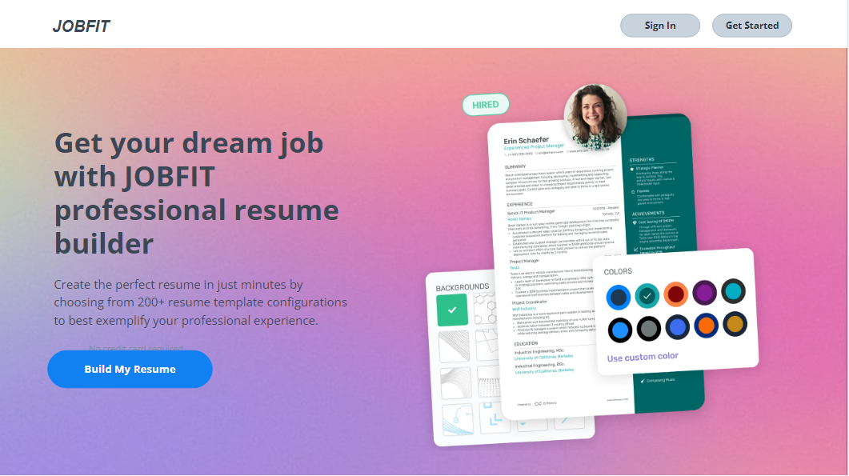
Welcome to JOBFIT

Slide 2


JOBFIT
Customize Your Path to Success
PRESENTED BY:
Agni Chaturvedi (NUID: 002675924)

Slide 3
Problem Statement
People face challenges in effectively managing their job search process, including creating professional resumes, tailoring them for specific job applications, and tracking their job applications
JobFit streamlines the resume and portfolio creation process by allowing users to input their details effortlessly.
Users simply enter their information, and it creates customized resumes and portfolios, showcasing their skills and experiences.
It offers tools and templates to design personalized resumes and portfolios that effectively emphasize qualifications and achievements.
One of the standout features of JobFit is its ability to analyze job descriptions. By leveraging advanced algorithms, JobFit can tailor resumes to match the requirements of specific job postings. It identifies key skills and qualifications from the job description and suggests relevant keywords to optimize the resume for success.
It conveniently keeps track of all job applications in a single location.

Slide 4
Product Objectives
User-Friendly Interface: Ensure that the website offers an intuitive and easy-to-use interface for creating resumes and portfolios, allowing users of all skill levels to navigate and utilize the platform efficiently.
Customization Options: Provide a wide range of customization options, including templates, fonts, colors, and layouts, to allow users to tailor their resumes and portfolios to their specific preferences and branding needs.
Mobile Compatibility: Optimize the website for mobile devices to ensure that users can create, edit, and view their resumes and portfolios seamlessly on smartphones and tablets, enhancing accessibility and user experience.
Integration with Professional Platforms: Enable seamless integration with professional platforms such as LinkedIn, allowing users to import data and information directly from their profiles to populate their resumes and portfolios, saving time and effort.
Continuous Improvement: Commit to ongoing updates and improvements based on user feedback and technological advancements, ensuring that the website remains relevant and competitive in meeting the evolving needs of its users.

Slide 5
Product Objectives
Guided Assistance: Provide step-by-step guidance and tips throughout the resume and portfolio creation process to help users highlight their skills and experiences effectively.
Security Measures: Implement robust security measures to safeguard users' personal information and ensure their data privacy throughout their interactions with the website.
Social Sharing Features: Enable users to easily share their resumes and portfolios on social media platforms or via email, allowing them to expand their professional network and reach potential employers or clients.

Slide 6
Target Audience:
Job Seekers: Individuals actively searching for employment opportunities across various industries and job roles.
Freelancers: Freelancers looking to showcase their skills, past projects, and expertise to attract potential clients.
Students/Recent Graduates: Students or recent graduates aiming to create professional resumes and portfolios to kickstart their careers.
Professionals Seeking Career Advancement: Professionals aiming to advance in their careers or transition to new industries by highlighting their accomplishments and skills.
Creative Professionals: Artists, designers, writers, photographers, and other creative professionals looking to showcase their portfolios and attract potential clients or employers.

Slide 7
User Needs
Efficient Resume Creation: Users need a simple and intuitive tool to create professional resumes that effectively showcase their skills and experiences.
Tailored Job Search: Users require features that allow them to customize their job search based on their qualifications, preferences, and desired industries.
Centralized Application Tracking: Users need a centralized platform to manage and track all their job applications, interviews, and follow-up actions in one place.
Customization Options: Users appreciate customization features that allow them to personalize their resumes and portfolios to better suit their individual preferences and career goals.
Privacy and Security: Users expect their personal and sensitive information to be kept secure and protected while using JobFit, ensuring their privacy is maintained throughout the job search process.

Slide 8
Simple Use Case
Use Case 1: Create Resume
Actor: User
Basic Flow:
The user logs/Signs into JobFit.
User completes their profile section.
User selects the "Resume Template" option from the dashboard.
User is presented with a template selection screen, offering various styles and formats.
User chooses a template that suits their preferences and career goals.
JobFit prompts the user to download or print the resume for their use.

Slide 9
Middle-Weight Use Case 1
Use Case 1: Create Resume
Actor: User
Basic Flow:
  User logs into the JobFit website.
  User navigates to the “Complete profile" section.
  User inputs personal and professional details.
  User selects desired templates for the resume.
  User saves the completed resume to their account.
Alternative Flow 1: If the user encounters difficulties in selecting formatting options, they can choose a pre-designed template.
Alternative Flow 2: If the user wishes to import existing resume details, they can upload a resume file for automatic input.
Alternative Flow 3:If the user encounters difficulties in editing their resume content, JobFit offers real-time editing assistance, providing suggestions and tips to improve the clarity and effectiveness of their resume.

Slide 10
Middle-Weight Use Case 2
Use Case 2: Tailor Resume
Actor: User
Basic Flow:
  User accesses the "Tailor Resume" feature on JobFit.
  User submits a job description to tailor their resume for.
  User reviews the job description and suggested keywords provided.
  User adjusts the content of their resume to match the job requirements.
  User saves the tailored version of the resume to their account.
Alternative Flow 1: If the user is unsure about adjusting their resume, they can access tips and suggestions provided by JobFit.
Alternative Flow 2: If the user wants to highlight specific skills or experiences in their tailored resume, JobFit provides assistance in identifying and emphasizing key qualifications based on the job requirements.
Alternative Flow 3: If the user is applying for a job in a specialized industry, JobFit offers industry-specific customization options, allowing for tailored resume adjustments that cater to the unique needs and expectations of that industry

Slide 11
Heavy-Weight Use Case 1
Use Case: Resume Creation and Tracking Workflow
Actor: User
Use Case Overview: This scenario involves the user creating a resume on JobFit and subsequently tracking the job application process.
Subject Area: Resume Management and Job Application Tracking
Trigger: User initiates the process of creating a resume and applying for jobs.
Preconditions:
User has an active account on JobFit.
User is logged into their account.
Basic Flow:
User accesses the "complete profile" feature within JobFit.
User inputs personal and professional details, including contact information, work experience, education, skills, and achievements.
User selects desired formatting options and designs for the resume.

Slide 12
Heavy-Weight Use Case 1
User reviews and edits the resume content as necessary.
User saves the completed resume to their JobFit account.
User navigates to the "Job Application Tracker" section on JobFit.
User inputs details of recently submitted job applications, including company name, position, application status, and application deadline.
User receives notifications and updates on the status of their applications.
User tracks follow-up actions and communication with potential employers using the Job Application Tracker.
Termination Outcome: User successfully creates a resume on JobFit and tracks the job application process in a centralized manner, enabling efficient management of the job search journey.
Alternative Flow 1: Template Selection Assistance
If the user finds it challenging in designing their resume, they can opt for pre designed templates provided by JobFit.
User selects a template from the provided options and proceeds with resume creation.

Slide 13
Heavy-Weight Use Case 1
Alternative Flow 2: Automated Job Application Tracking
If the user prefers automated tracking of job applications, JobFit offers an option to sync with external job portals and email accounts.
User grants permission for JobFit to access their email inbox or job portal accounts.
JobFit automatically detects and imports job application details, including company name, position, and application status.
User receives notifications and updates on the status of their applications without manual input.
Alternative Flow 3: Resume Customization based on Application
If the user wants to tailor their resume for a specific job application, they access the "Tailor Resume" feature within JobFit.
User selects a job posting from their list of applications.
JobFit analyzes the job description and suggests modifications to the user's resume to match the job requirements.
User reviews and approves the suggested modifications before saving the tailored resume to their account.

Slide 14
Heavy-Weight Use Case 2
Actor: User
Use Case Overview: This scenario involves JobFit automatically tailoring the user's resume for specific job applications by suggesting relevant keywords and updating the resume accordingly.
Subject Area: Resume Customization
Trigger: User seeks to customize their resume to match the requirements of a particular job posting.
Preconditions:
User has an active account on JobFit.
User has uploaded their resume to JobFit.
Basic Flow:
User navigates to the "Resume Tailoring" section within JobFit.
User selects the option to tailor their resume for a specific job application.
User enters the job title or keywords for the desired job position.
JobFit analyzes the job description and identifies relevant keywords, skills, and qualifications.
JobFit suggests a list of keywords to add to the user's resume based on the job requirements.
User reviews the suggested keywords and chooses to accept or reject them.
If accepted, JobFit automatically updates the resume by incorporating the suggested keywords into the appropriate sections.
User reviews the updated resume to ensure accuracy and completeness.
Once satisfied, user saves the tailored version of their resume.

Slide 15
Heavy-Weight Use Case 2
Termination Outcome: User's resume is effectively tailored for the specific job application with the addition of relevant keywords, increasing its alignment with the job requirements and improving its chances of being noticed by employers.
Alternative Flow 1: Customized Keyword Suggestions
If the user has specific preferences or requirements, they provide additional information regarding their target industries or job roles.
JobFit tailors the keyword suggestions to align with the user's preferences and goals, providing personalized recommendations for resume customization.
Alternative Flow 2: Automatic Resume Updating
If the user prefers a hands-off approach, they opt for automatic resume updating within JobFit.
User grants permission for JobFit to automatically update their resume based on the suggested keywords.
JobFit makes the necessary changes to the resume without requiring manual intervention from the user, ensuring a seamless and efficient tailoring process.
Alternative Flow 3: Revision History and Undo Functionality
After the resume is updated, the user has the option to review the revision history within JobFit.
User can track the changes made to the resume and revert to previous versions if needed.
JobFit provides an undo functionality, allowing users to undo any undesired changes or revert to the original resume state with ease.

Slide 16
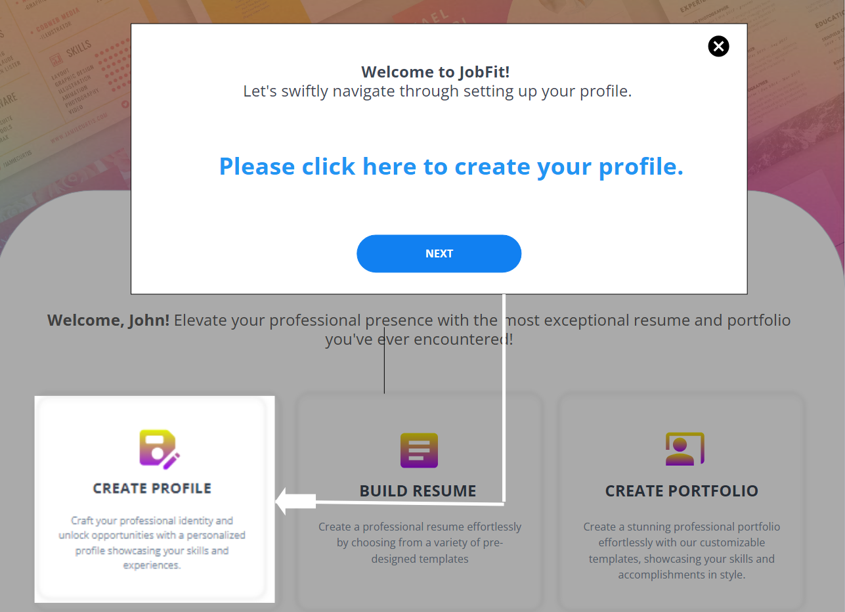
Onboarding

Slide 17
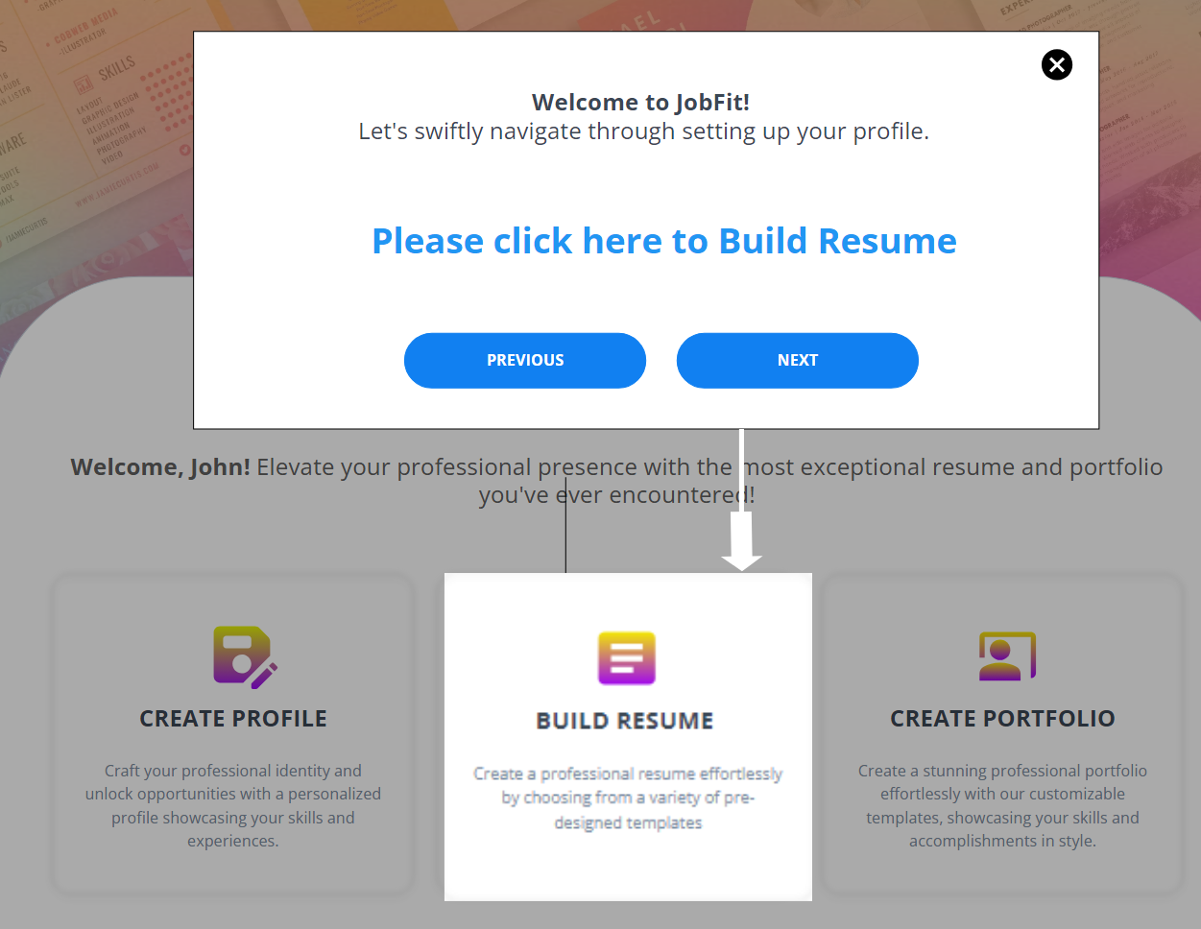
Onboarding

Slide 18
User Research methods
We utilized below Qualitative User Research methods:
  Persona Creation: We're creating fictional characters that represent different types of people who might use JobFit. This helps us understand our users better.
  SWOT Analysis: We're looking at what we're good at, what we're not so good at, what opportunities we have, and what challenges we might face. This helps us plan for the future.
  Competitive Analysis: We're looking at other similar websites to see what they're doing well and what they're not. This helps us understand how we can make JobFit better.

Slide 19
Method 1 - Persona Creation
Persona creation allows us to empathize with users and tailor the JobFit website to meet their specific needs. By understanding the goals, pain points, and preferences of different user segments, we can design a user-centric experience that resonates with our target audience.
This involves creating fictional characters that represent different types of people who might use JobFit. It helps us understand our users better.
Personas give us a clear picture of who we're designing for. By understanding our users' needs and preferences, we can create a website that meets their needs and makes them happy.

Slide 20
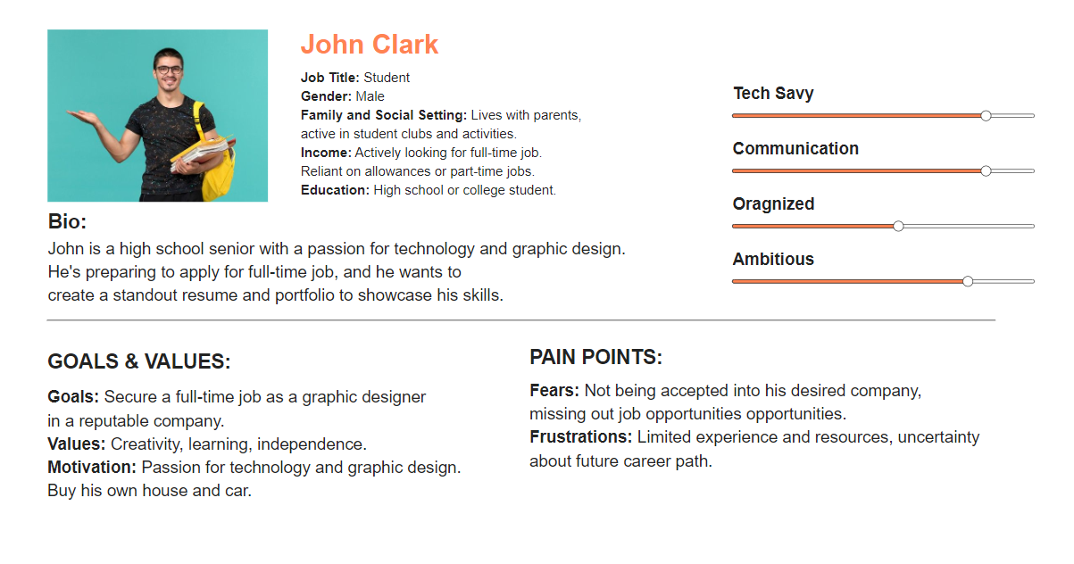
Persona 1 – Mr. John Clark

Slide 21
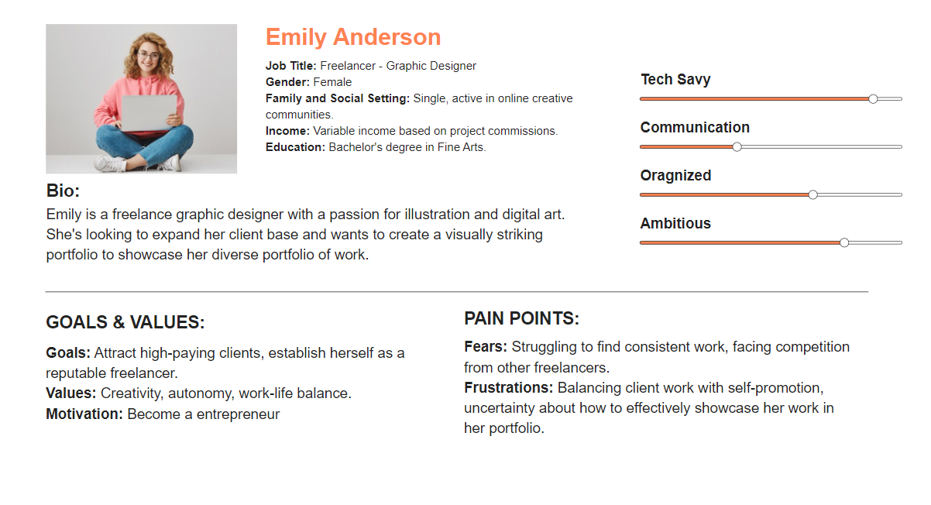
Persona 2 – Ms. Emily Anderson

Slide 22
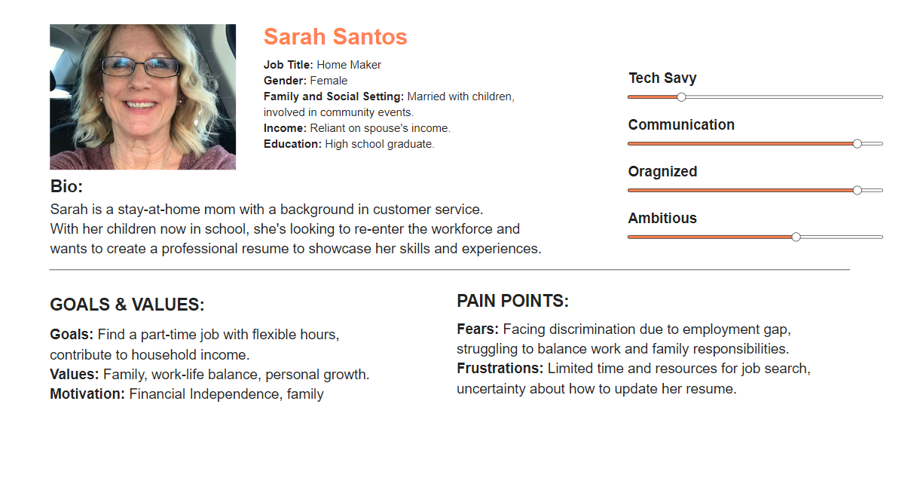
Persona 3 – Mrs. Sarah Santos

Slide 23
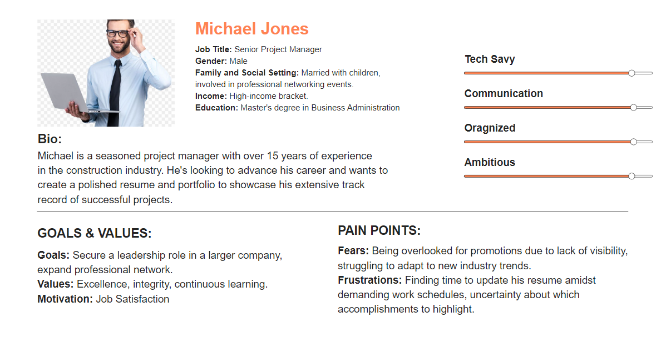
Persona 4 – Mr. Michael Jones

Slide 24
Method 2 - SWOT Analysis
SWOT analysis helps us identify internal factors that JobFit can leverage, such as unique features or expertise, as well as potential challenges and opportunities in the external environment. This analysis informs strategic decision-making and helps in developing a robust business strategy.
SWOT analysis looks at what we're good at, what we're not so good at, what opportunities we have, and what challenges we might face. This helps us plan for the future.
By knowing our strengths, we can focus on what we do best. By understanding our weaknesses, we can work on improving them. By identifying opportunities, we can take advantage of them. And by recognizing threats, we can prepare for them.

Slide 25
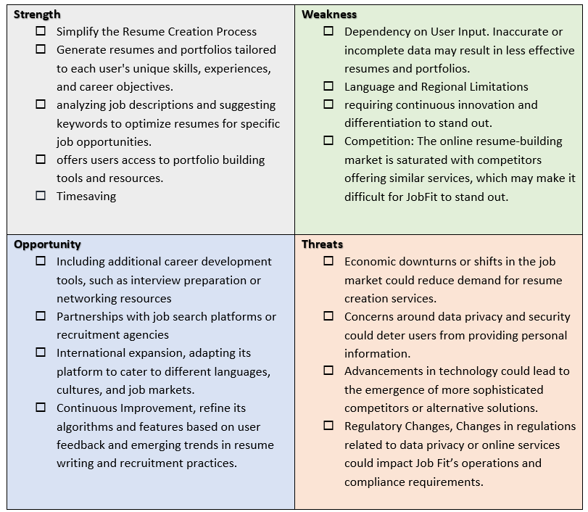
SWOT ANALYSIS - JOBFIT

Slide 26
Method 3 - Competitive Analysis
We have chosen competitive analysis to gain insights into competing websites offering similar services. By understanding what competitors are doing well and where they are lacking, we can identify areas for differentiation and improvement for JobFit.
This involves looking at other similar websites to see what they're doing well and what they're not. It helps us understand how we can make JobFit better.
  By learning from our competitors, we can avoid making the same mistakes and find new ideas to improve JobFit.
Competitive Analysis - JOBFIT

Slide 27
Conclusion
JobFit provides a seamless and empowering experience for individuals embarking on their career journeys. With a commitment to user-centric design and a dedication to understanding the diverse needs of our audience, JobFit will and definitely emerge as a trusted ally in the competitive job market.
With a primary focus on resume and portfolio creation, JobFit offers an intuitive platform equipped with features to tailor resumes and portfolios according to job descriptions, ensuring maximum relevance and impact.
By providing users with the ability to track all job applications in one centralized site, JobFit saves time and effort .

Slide 28

THANK YOU!

